Slide 1
Data Augmentation in NLP
Bhuvana Basapur

Slide 2
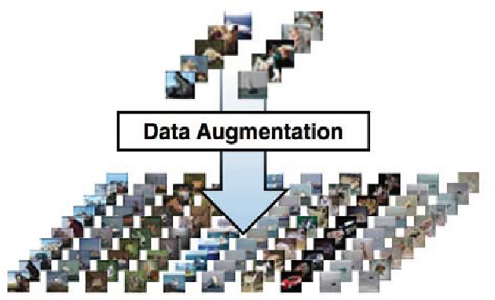
What is Data Augmentation (DA)
Alleviates Data Scarcity problem
Creation of synthetic data without directly collecting more data
Methods used to increase the amount of data by adding slightly modified copies of already existing data or newly created synthetic data from existing data.
Applied in many fields

Slide 3
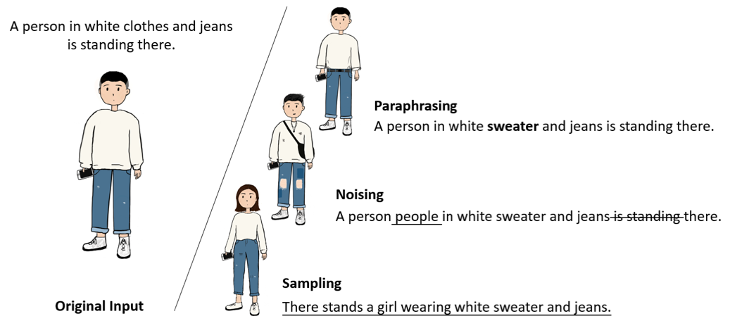
Categories
Paraphrasing: Generates paraphrases of the original data as augmented data. It brings very limited changes when compared to the original data
Noising: Adds continuous or discrete noise to the original data and involves more changes.
Sampling: Master the distribution of the original data to sample new data as augmented data and can generate very diverse data.

Slide 4
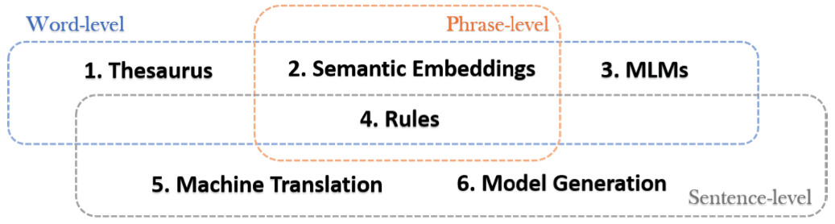
Paraphrasing

Slide 5
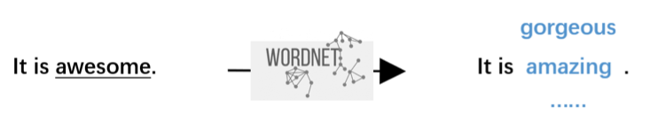
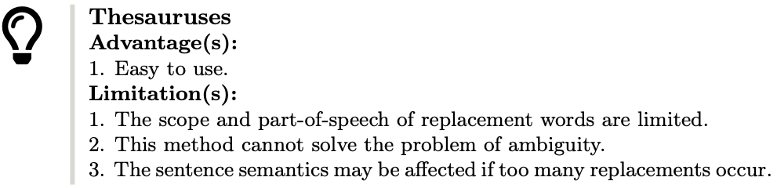
Thesaurus

Slide 6
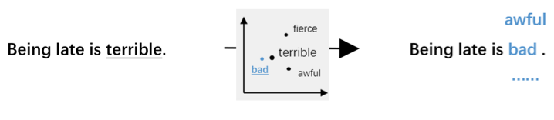
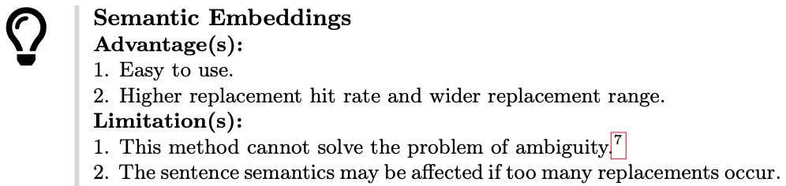
Semantic Embeddings

Slide 7
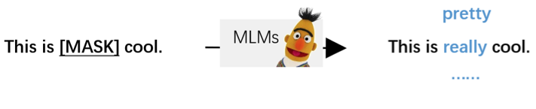
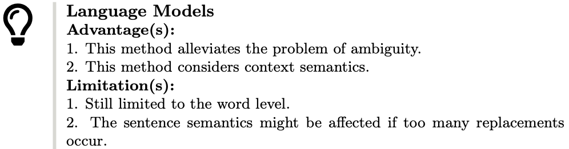
Language Models

Slide 8
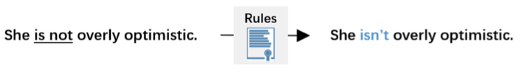
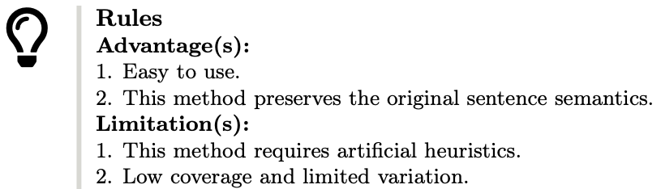
Rules

Slide 9

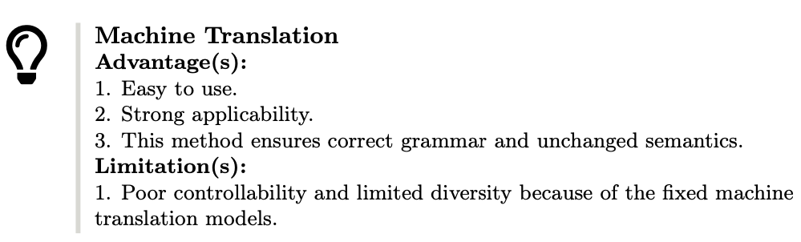
Machine Translation

Slide 10
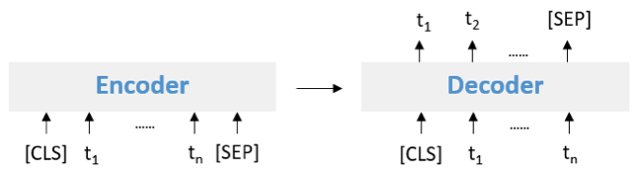
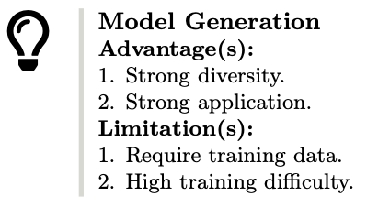
Model Generation

Slide 11
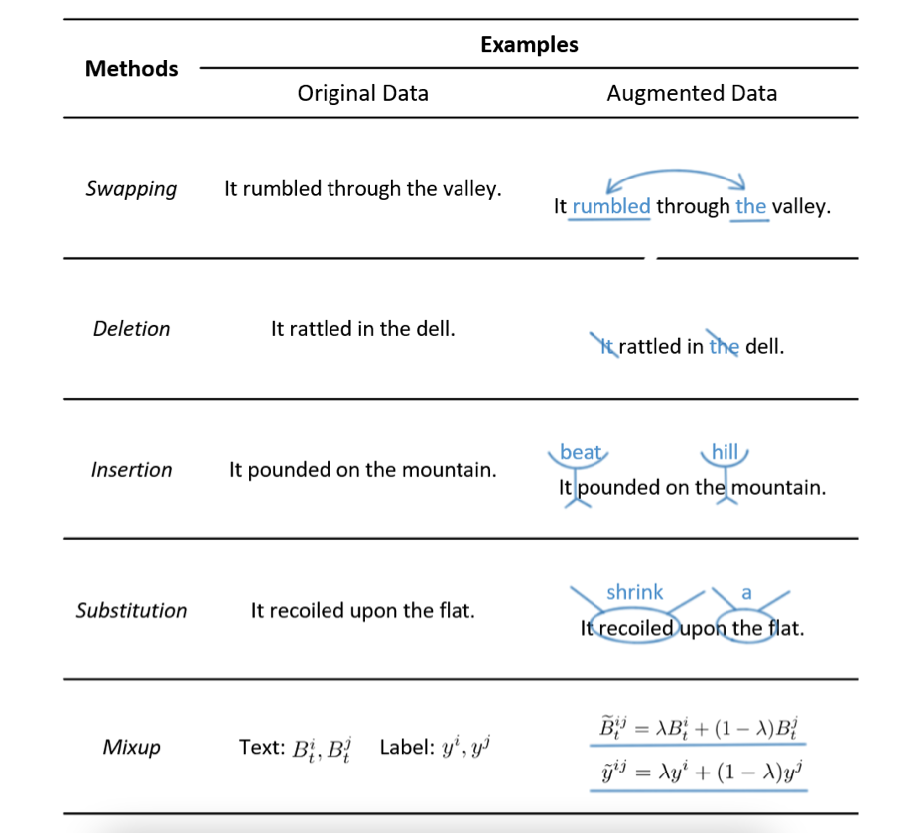
Noising Based Methods

Slide 12
Sampling Based Methods
Master the data distributions and sample novel points within them.

Slide 13
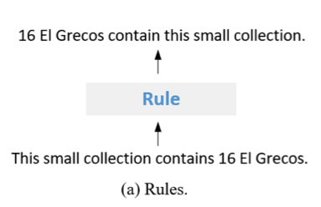
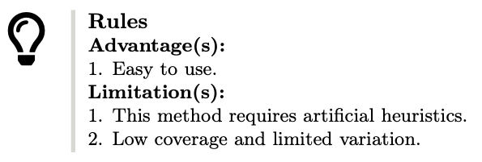
Rules

Slide 14
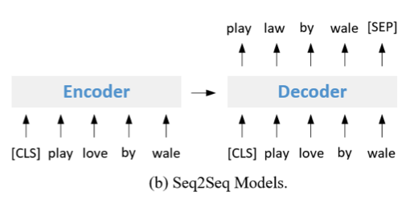
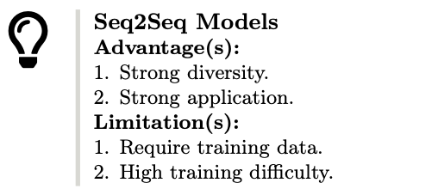
Seq2Seq models

Slide 15
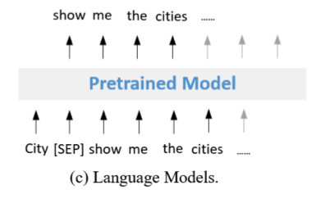
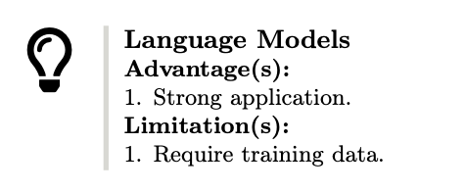
Language Models

Slide 16
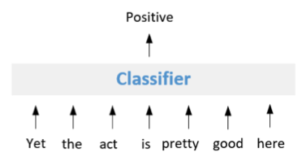
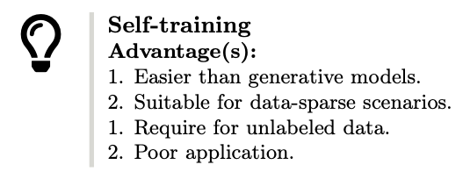
Self Training

Slide 17
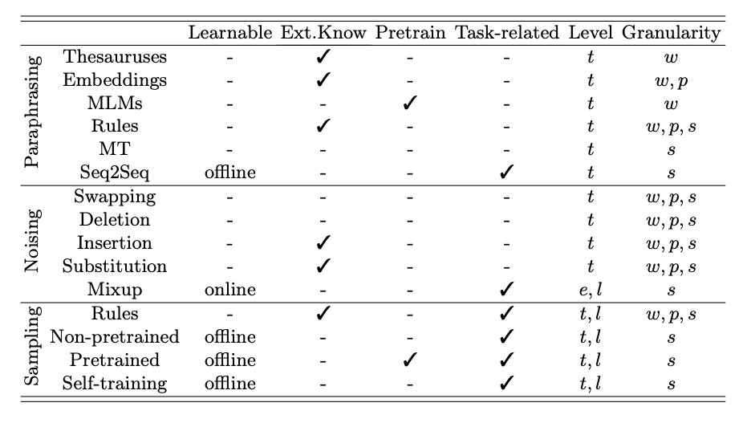
Analysis
Learnable denotes whether the methods involve model training; online and offline denote online learning and offline learning, respectively. Ext.Know refers to whether the methods require external knowledge resources to generate augmented data. Pretrain denotes whether the methods require a pre- trained model. Task-related denotes whether the methods consider the label information, task format, and task requirements to generate augmented data. Level denotes the depth and extent to which elements of the instance/data are modified by the DA; t, e, and l denote text, embedding, and label, respectively. Granularity indicates the extent to which the method could augment; w, p, and s denote word, phrase, and sentence, respectively.

